Slide 1


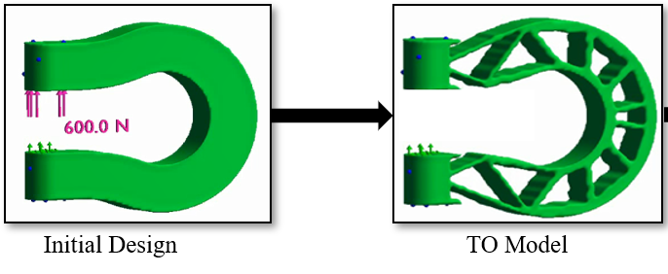
Tutorial 1
Learning Topology Optimization Through Examples and Case Studies
August 18, 2019

Slide 2
Cost-Effective Functional Designs
for Additive Manufacturing

Slide 3
Outline
Support structure constraint
A. M. Mirzendehdel and K. Suresh, “Support structure constrained topology optimization for additive manufacturing”, Computer-Aided Design, vol. 81, pp. 1–13, 2016.
Anisotropic strength
A. M. Mirzendehdel, B. Rankouhi, and K. Suresh, “Strength-based topology optimization for anisotropic parts”, submitted to Additive Manufacturing, 2016.

Slide 4
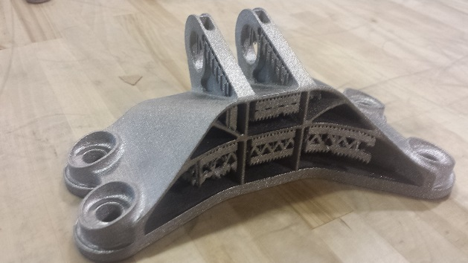
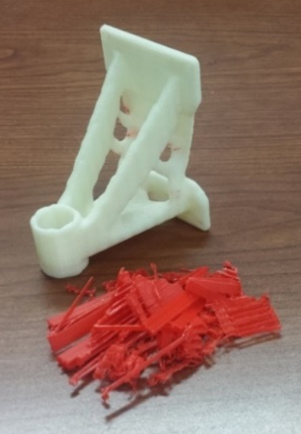
Reducing support in TO
Reducing Support in AM Parts
Reduction in:
material usage
fabrication time
clean-up time
“… there will probably be instances where it is not necessary for all support structure to be eliminated and so the user should be able to have some control over the strength of the penalty function.” (Brackett et. al 2011 )

Slide 5
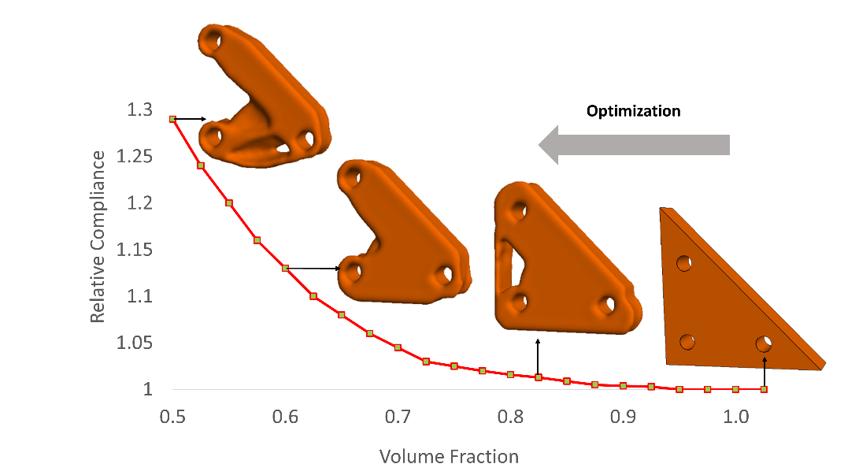
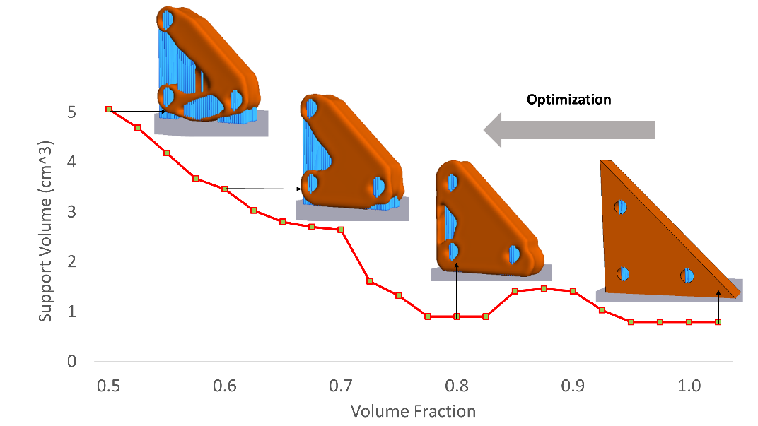
Proposed
What is a reasonable constraint on Support?
Support structure volume must be reduced during optimization
but …
What is the impact on Performance?
First optimize without support structure constraint
Performance Evaluation
Support Volume Evaluation

Slide 6
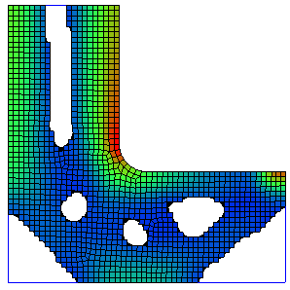
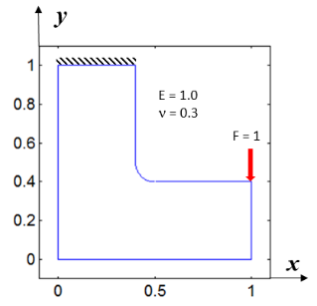
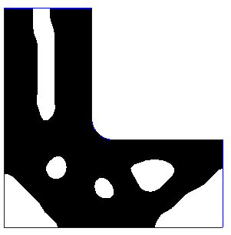
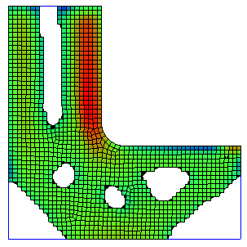
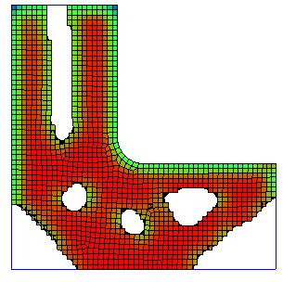
Lagrangian
Where to remove material?
Find sensitivity of the design to hypothetical infinitesimal change!
Combination
Sensitivity field for Compliance
Sensitivity field for Support

Slide 7
Support Sensitivity Analysis
Interior
Boundary
Overhang Point
Threshold angle
Support Point
Length
Support depends on
Local Normal

Slide 8
Constrained vs. Unconstrained
Volume fraction = 0.5
Unconstrained

Slide 9
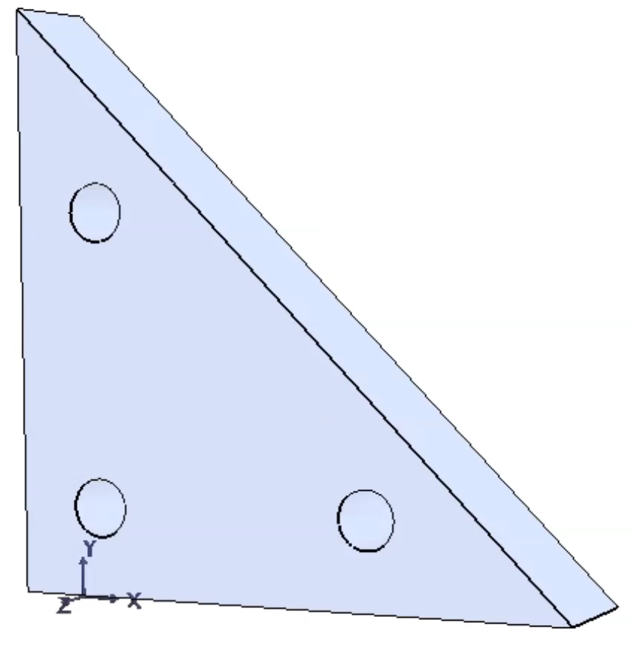
Constrained vs. Unconstrained
Volume fraction = 0.5
 | J/J₀ | S (cm³)
Unconstrained | 1.24 | 5.46
Constrained | 1.58 | 2.21
 | 27%↑ | 60%↓
Unconstrained

Slide 10

Performance Tradeoff
Volume fraction = 0.7
Support volume reduced by about 17%
Compliance is increased by 137%
May not be possible !

Slide 11

Outline
Support structure constraint
A. M. Mirzendehdel and K. Suresh, “Support structure constrained topology optimization for additive manufacturing”, Computer-Aided Design, 2016.
Anisotropic strength
A. M. Mirzendehdel, B. Rankouhi, and K. Suresh, “Strength-based topology optimization for anisotropic parts”, submitted to Additive Manufacturing, 2016.

Slide 12
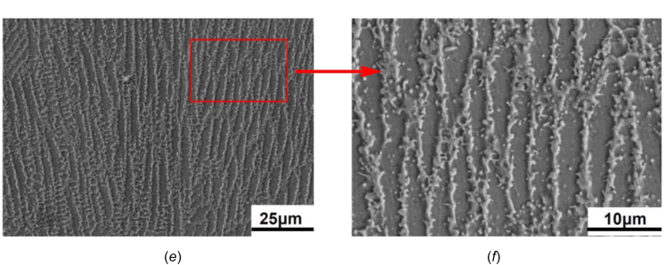
Introduction
Fused Deposition Modeling
Metal AM
Build
direction
“Incorporating … FDM processing to enhance strength … would significantly enhance a design optimization ...”
(Riddick et. al 2016)
“Metal fabrication processes rarely produce isotropic materials...”
(Luecke and Slotwinski 2014)
Anisotropy
Constitutive Properties
(relating stress and strain)
Directional Strengths

Slide 13
Anisotropic Failure Criteria
Isotropic
No directional preference
von Mises Stress
Anisotropic
directional preference
Tsai-Wu Criterion
Tsai-Wu Criterion:
Stress components are normalized w.r.t strength components.
Difference in compression vs. tension

Slide 14
Anisotropic Failure Criteria
Acceptable if less than 1
Normalizing w.r.t strength
Only determines if the part fails or not!

Slide 15
Anisotropic Strength Ratio
Determine safety factor?
Measure strength
Simplest case: inverse of uniaxial stress
Tsai-Wu (Mixed order) : solution of quadratic equation
Maximize strength ratio
or safety factor

Slide 16
Formulation
To avoid pathological conditions
Discretized approximation

Slide 17
Anisotropic Strength Sensitivity Analysis

Slide 18
Experiments
Fused Deposition Modeling:
Strength anisotropy along build direction under tension
Material properties for ABS plastic at raster orientation of
Material strength components
Ahn et al. (2002)
Riddick et al. (2016)
Ahn et al. (2003)
Printer setup
XYZ Da Vinci Duo
90% infill density (maximum)
Tensile actuator setup
MTS Criterion Model 43
5KN load cell
Run at 5 mm/min
Data collection at 100Hz

Slide 19
Stiffness vs. Strength – Numerical solution
Reduce weight by 80%
Stiffness
Strength

Slide 20
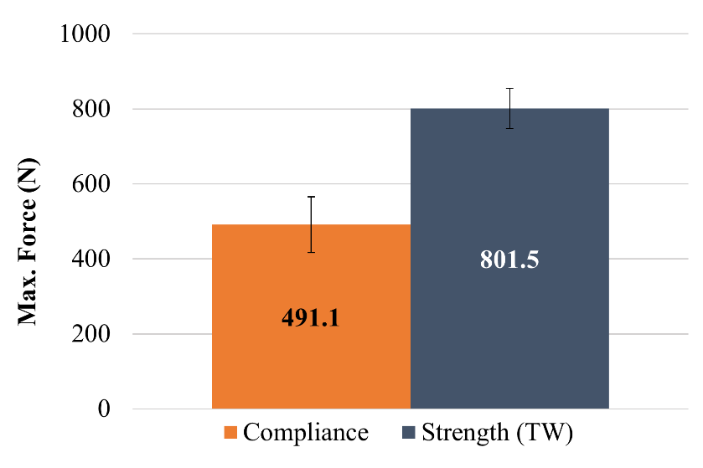
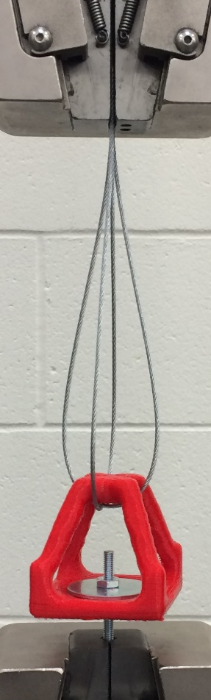
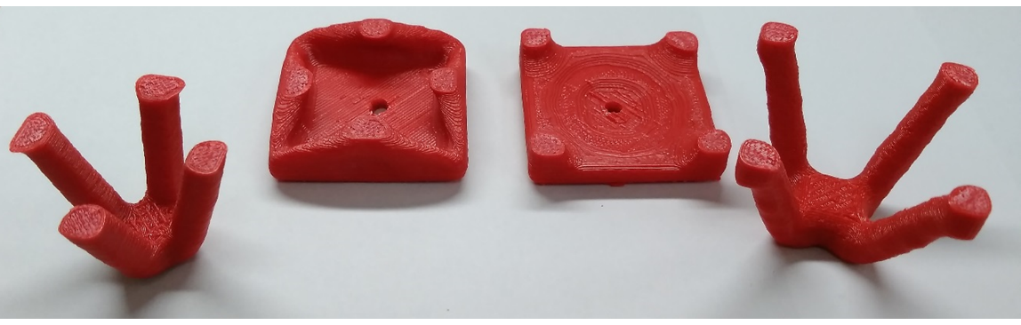
Stiffness vs. Strength – Experiments

Slide 21
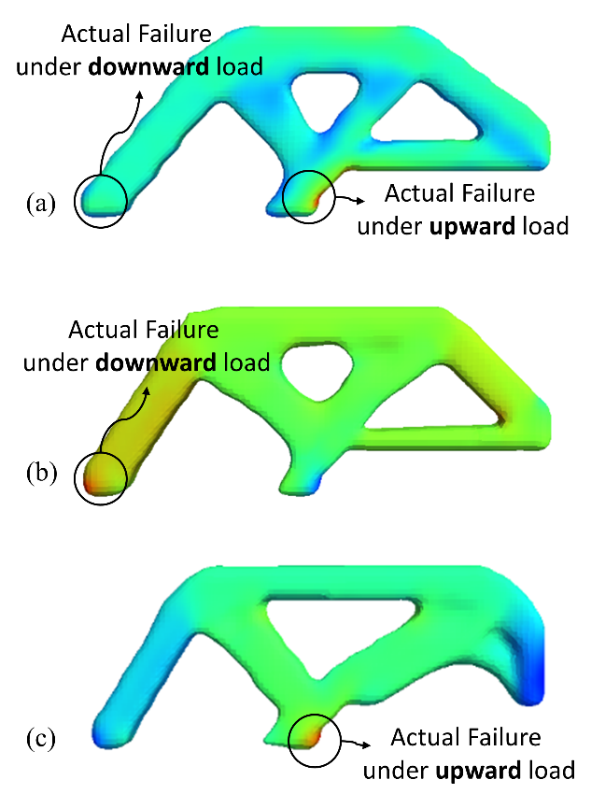

VonMises vs. Tsai-Wu – Numerical solution
Compression
Tension
Load
Load
vonMises (Isotropic)
Tsai-Wu (Anisotropic)
Tsai-Wu (Anisotropic)

Slide 22
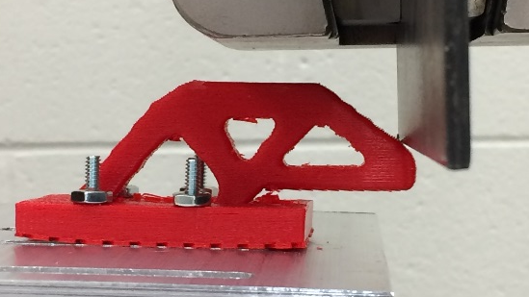
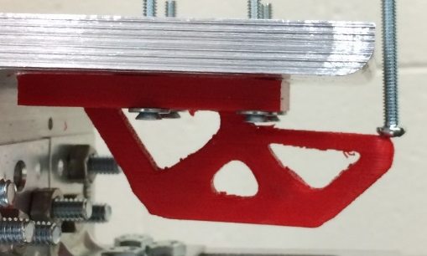
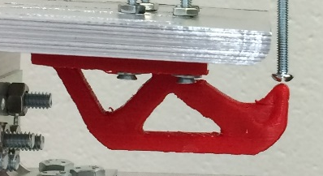
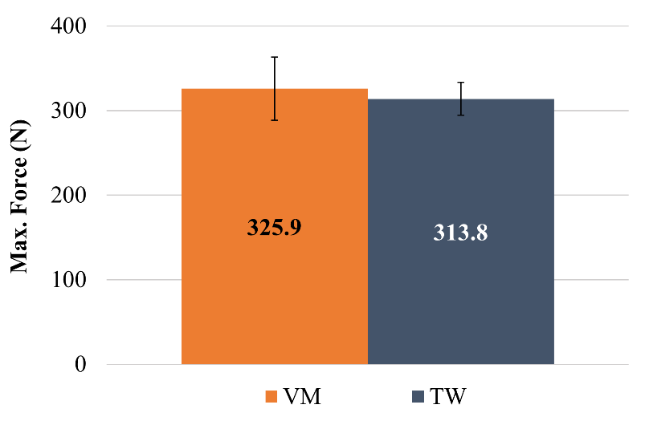
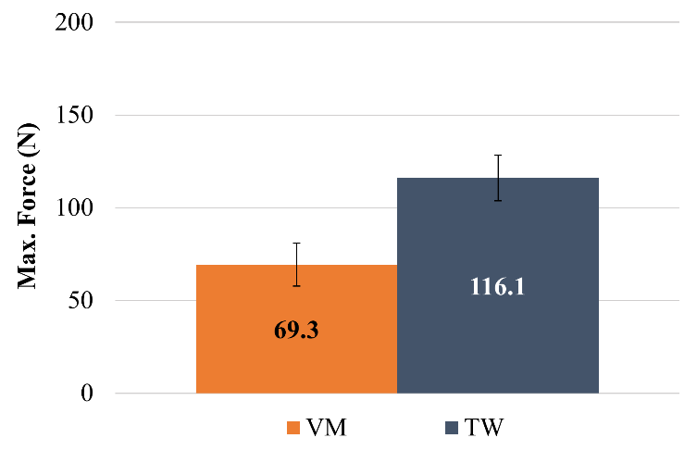
VonMises vs. Tsai-Wu – Experiments
Compression
Tension
Load
Load

Slide 23
Conclusion
Considered support constraint in TO by:
  Posing the constraint w.r.t unconstrained TO
  Considering tradeoff with performance
Considered strength anisotropy in TO:
  Generalized Failure criteria such as Tsai-Wu
  Significant improvement in FDM parts via experimental tests

Slide 24
Optimization method
Method: Pareto tracing
K. Suresh, “Efficient generation of large-scale pareto-optimal topologies,” Struct Multidisc Optim, vol. 47, no. 1, pp. 49–61, May 2012.
Optimal trade-off between objectives and constraints
Valid intermediate designs
Can make predictions throughout optimization
Minimize {Volume, Compliance}
Constraint on displacement, stress,…
Constraint on support volume (*)
Challenging!
Not explored in literature!

Slide 25
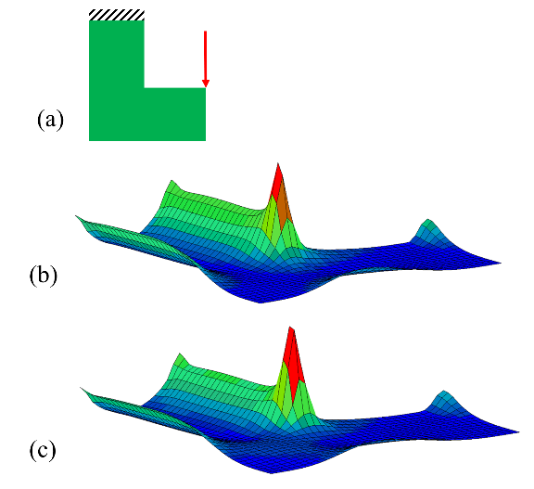

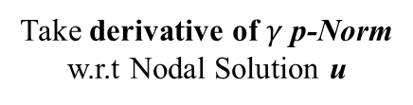
Sensitivity Analysis
Change in Compliance
Change in Quantity of Interest
Take derivative of $γ$p-Norm
w.r.t Nodal Solution u
Solve Adjoint problem
Compute element sensitivity

